Slide 1

Welcome!
While you wait
Have you done these?
Signed attendance for a drink (In front!)
Created a Github Account
Downloaded Github Desktop
Download VSCode (Highly recommended)
Links and materials
github.com/Wooniety/Github-Workshop
Notes:
Workshop for MSP
Admin questions ask HW / Sil
Welcome before starting

Slide 2
Random Challenge
Notes:
Only when workshop starts
If you ever feel bored I have this USB Data Blocker up for grabs
I hid a little text thing that looks something like FLAG{some_text_here} if you look through the repository carefully
Tell the helpers with red lanyard what's in the flag it's all yours
Ask the helpers during the workshop
I will ask for as well during the workshop

Slide 3
add in more slides on bad code examples
Teams
Winscp
Anydesk
Thumbdrive
Screenshare on discord

Slide 4
Github Workshop

Slide 5
Outline
What is Version Control & Github
Commits
Branching & Merge Conflicts
Pull Requests

Slide 6
1.
What is version control?
Why do we care?

Slide 7


What is version control?
Collaborate
Create anything with other people
Track & revert changes
See changes that have been made or going back in time

Slide 8
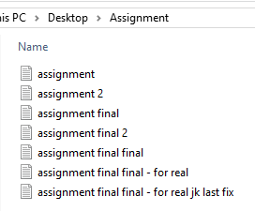
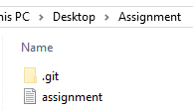
What is version control?

Slide 9
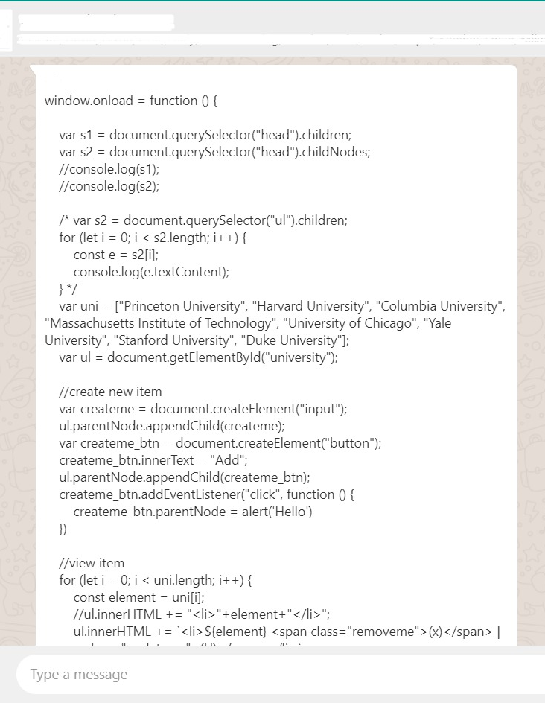
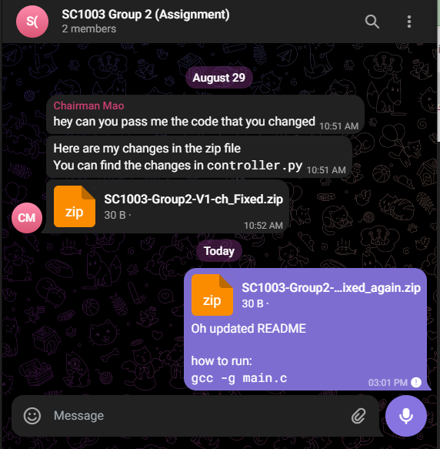
Coding with friends
Notes:
Good commit messages

Slide 10
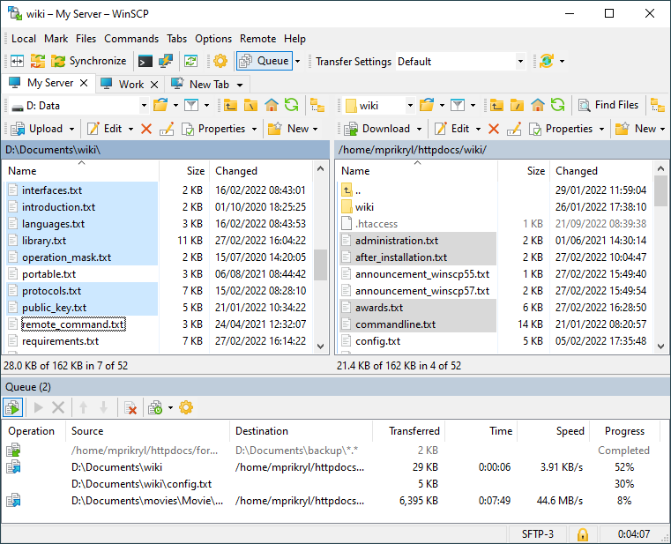
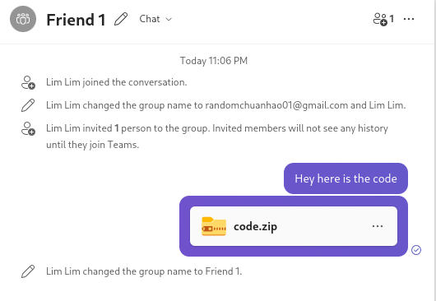
Coding with friends
Notes:
Good commit messages

Slide 11
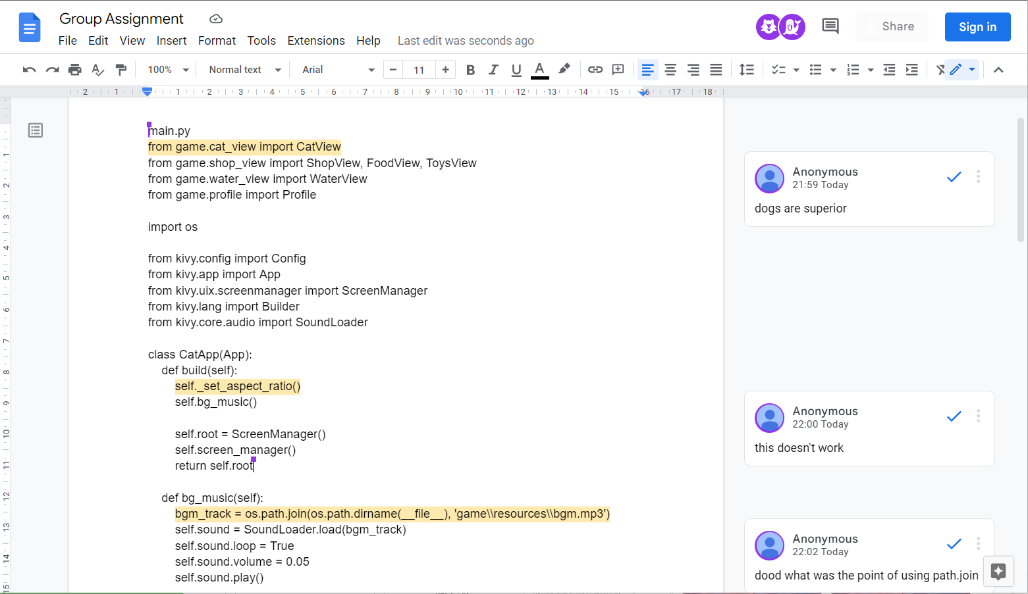
Coding with friends
Notes:
Good commit messages

Slide 12
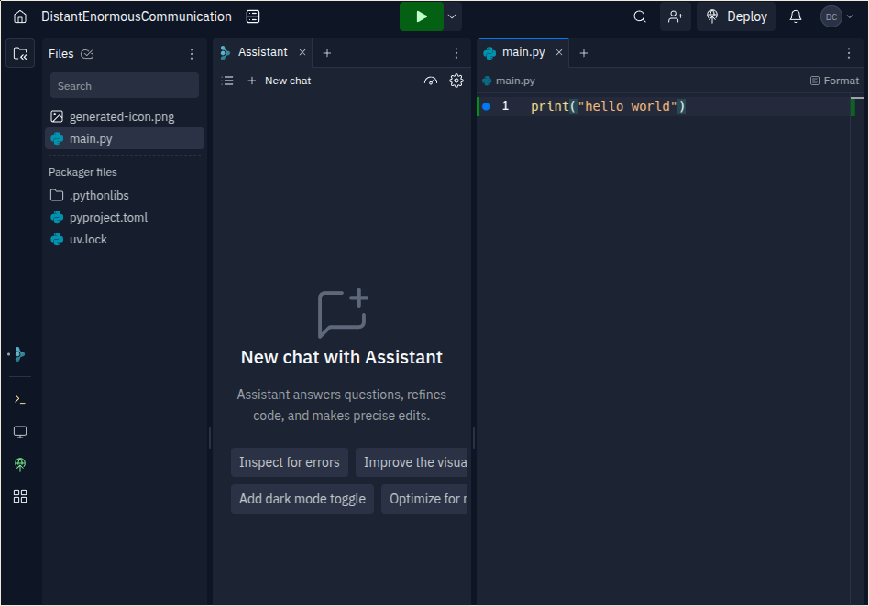
Coding with friends
Notes:
Good commit messages

Slide 13
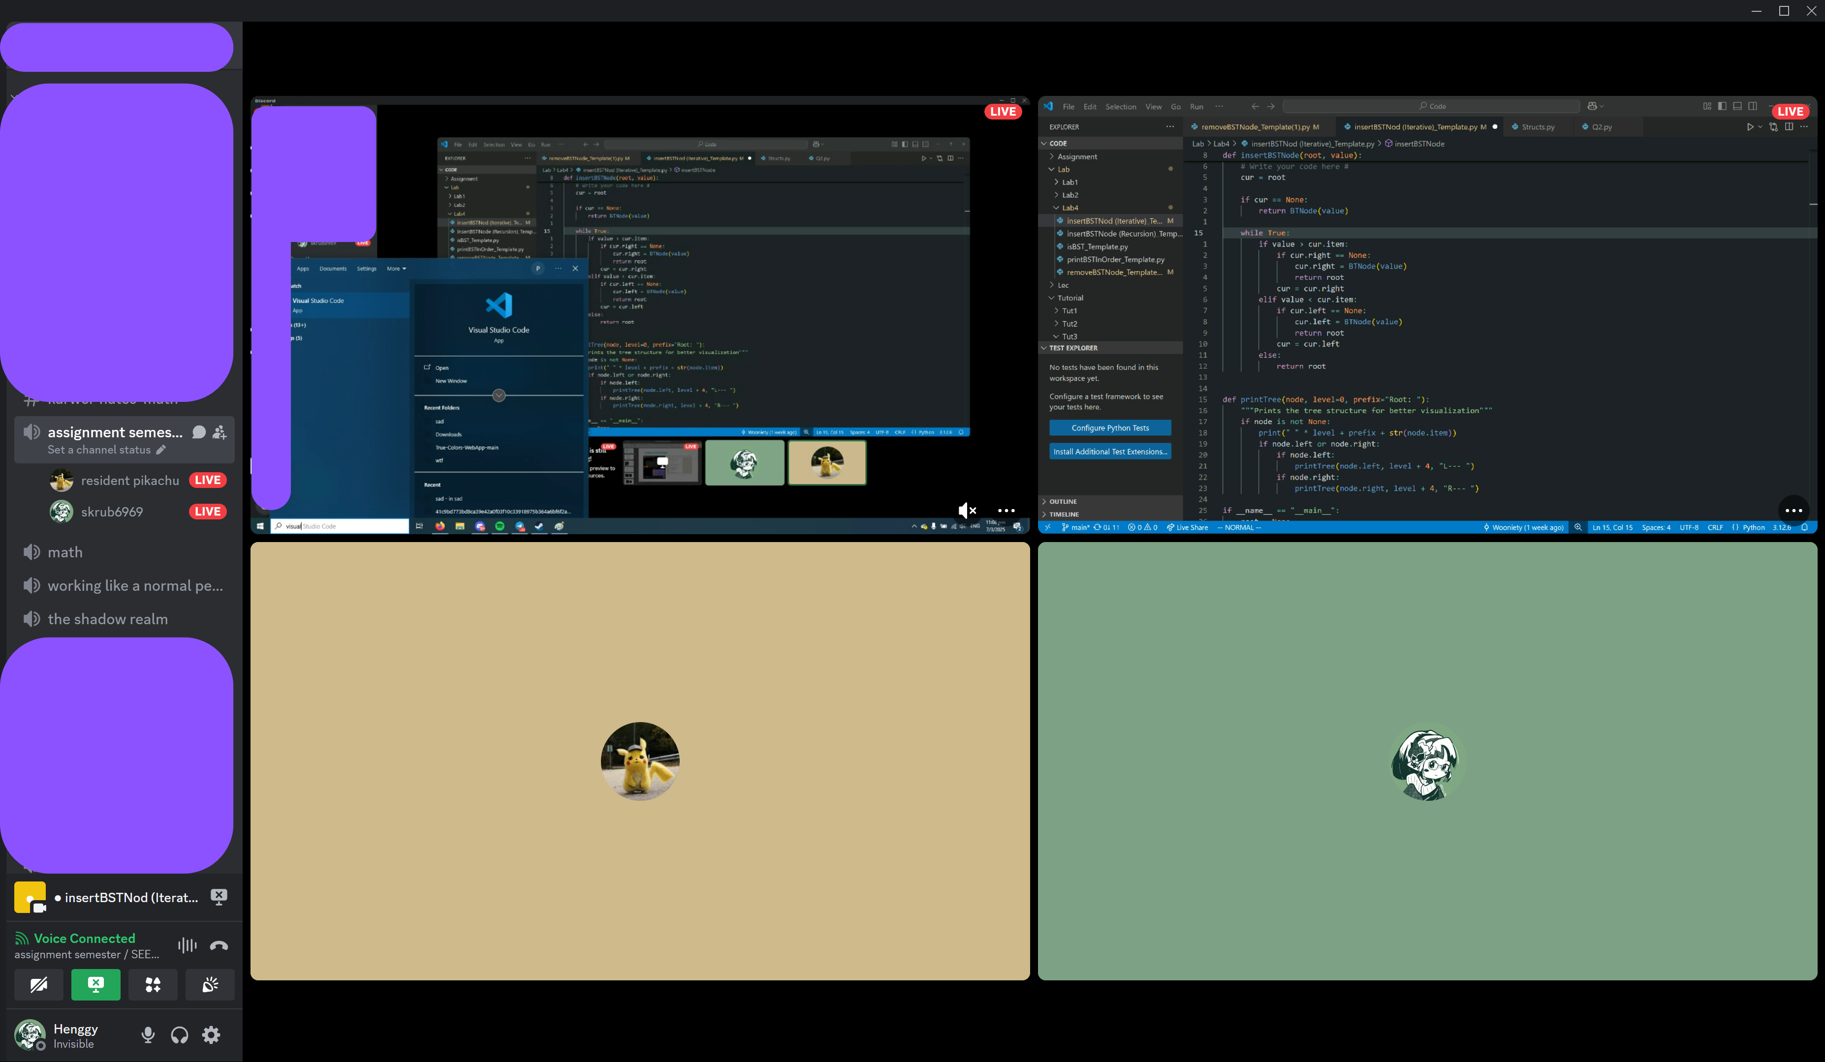
Coding with friends
Notes:
Good commit messages

Slide 14
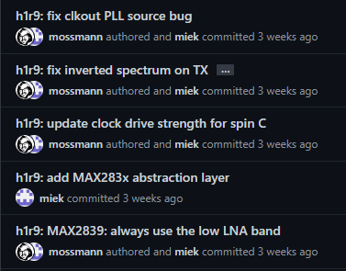
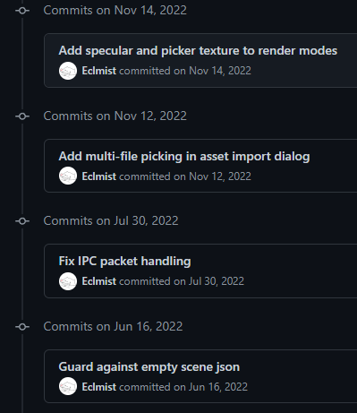
The Ideal
github.com/greatscottgadgets/hackrf
github.com/Eclmist/Matcha-Editor
Descriptive commit messages
Notes:
Good commit messages

Slide 15
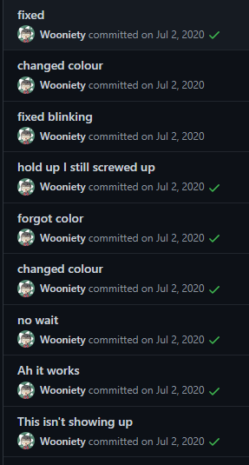
The Ideal
(?)
github.com/i’m-not-linking-this
(?)
Descriptive commit messages
Notes:
Show a github repo where u can look through
Previous versions of the entire code
And also see who made what changes (blame)

Slide 16
2.
Github
What is it?

Slide 17



git ≠ Github
≠

Slide 18
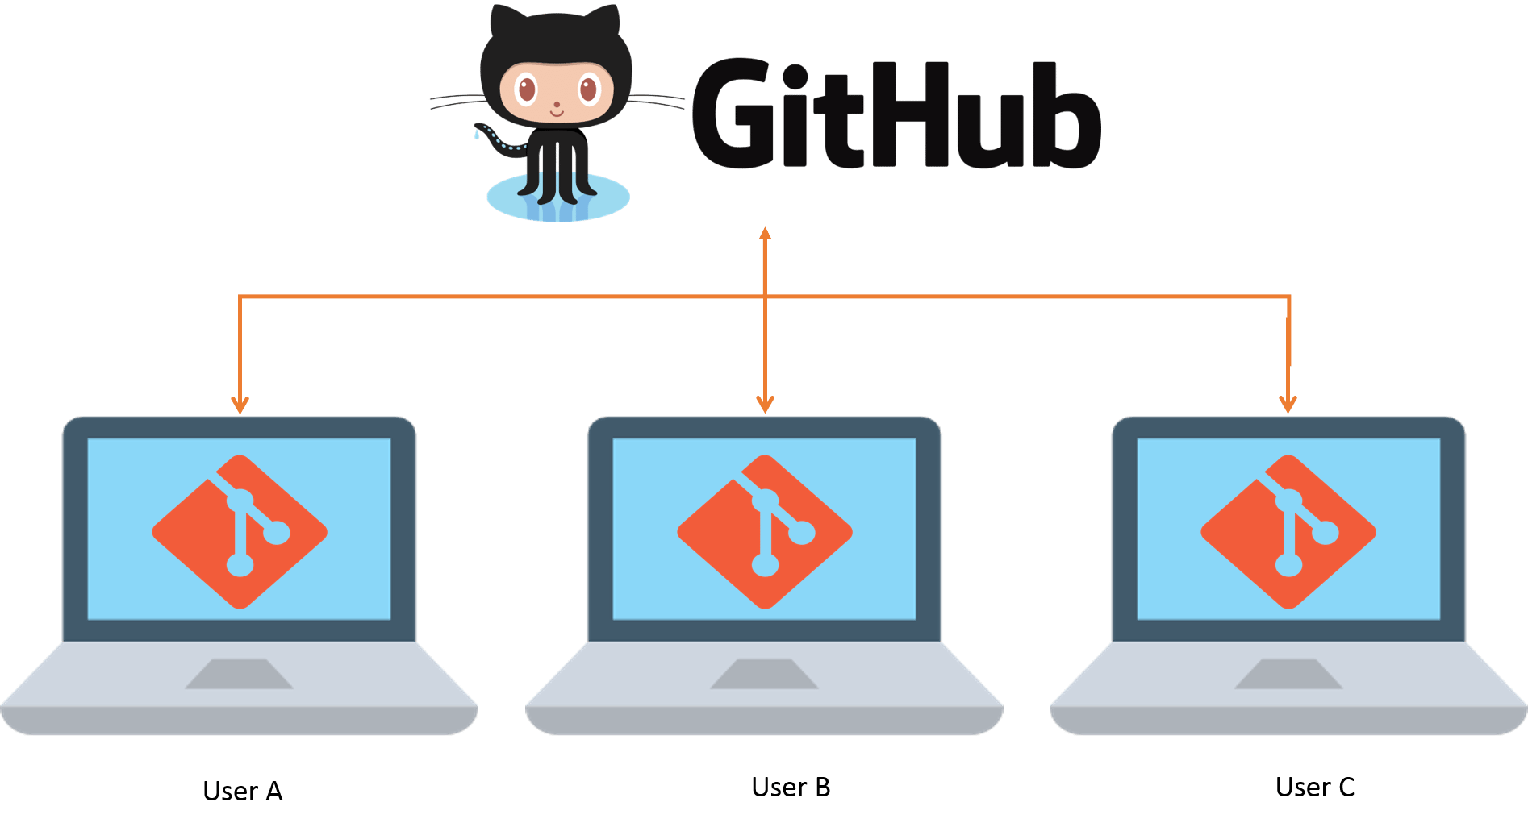
git ≠ Github

Slide 19
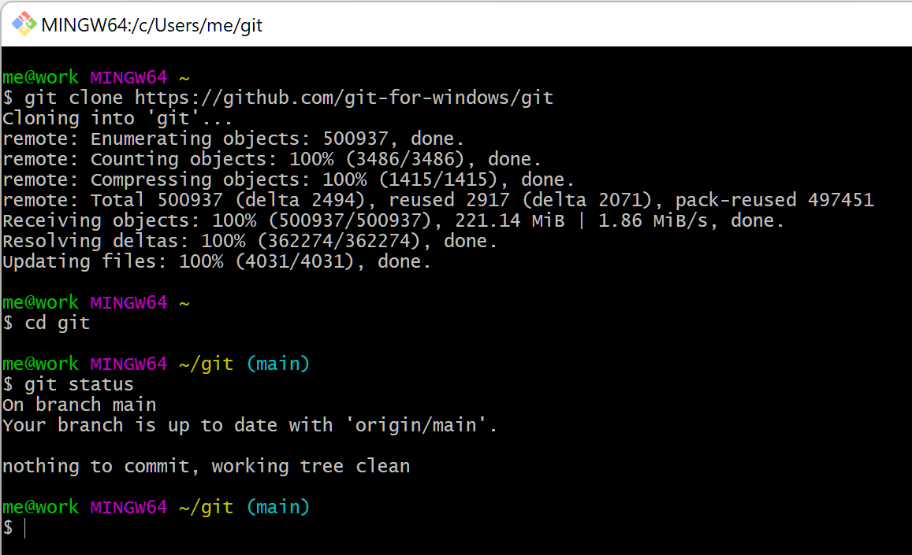
git
git is a Version control system software that you can run on your own computer, or on a server

Slide 20
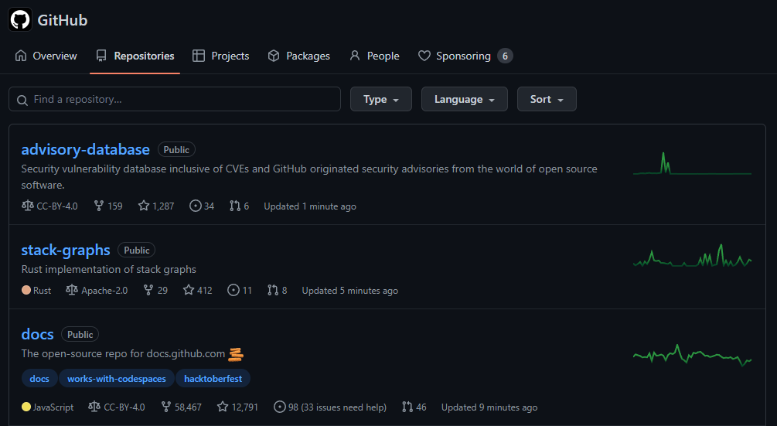
Github
GitHub is a Web-based service for storing, sharing, and collaborating on projects managed with Git

Slide 21
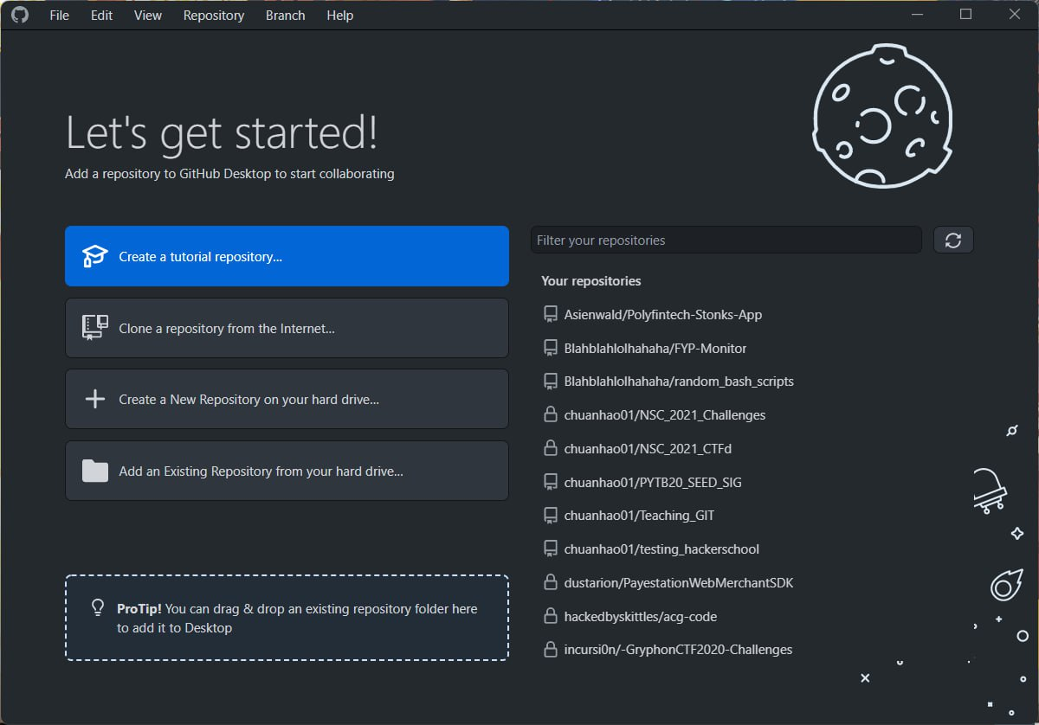

Github Desktop
An application made by Github made to use a GUI instead of the command line or web browser
Notes:
Create repo
Clone Repo

Slide 22
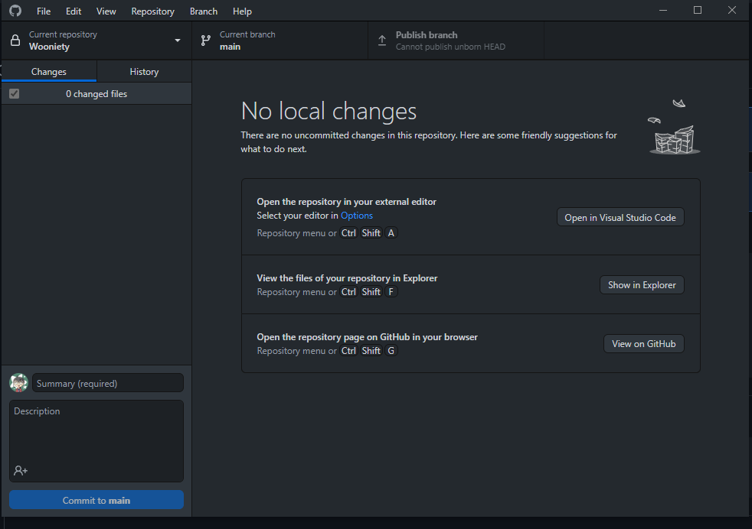
Github Desktop
Notes:
Showing the where the files are

Slide 23
Create a repository
The first project

Slide 24




Github Desktop
Computer
Github
About-Me
About-Me
Notes:
Showing the where the files are

Slide 25
Write an introduction
Introduce yourself on Github!
Notes:
Open their code editor

Slide 26
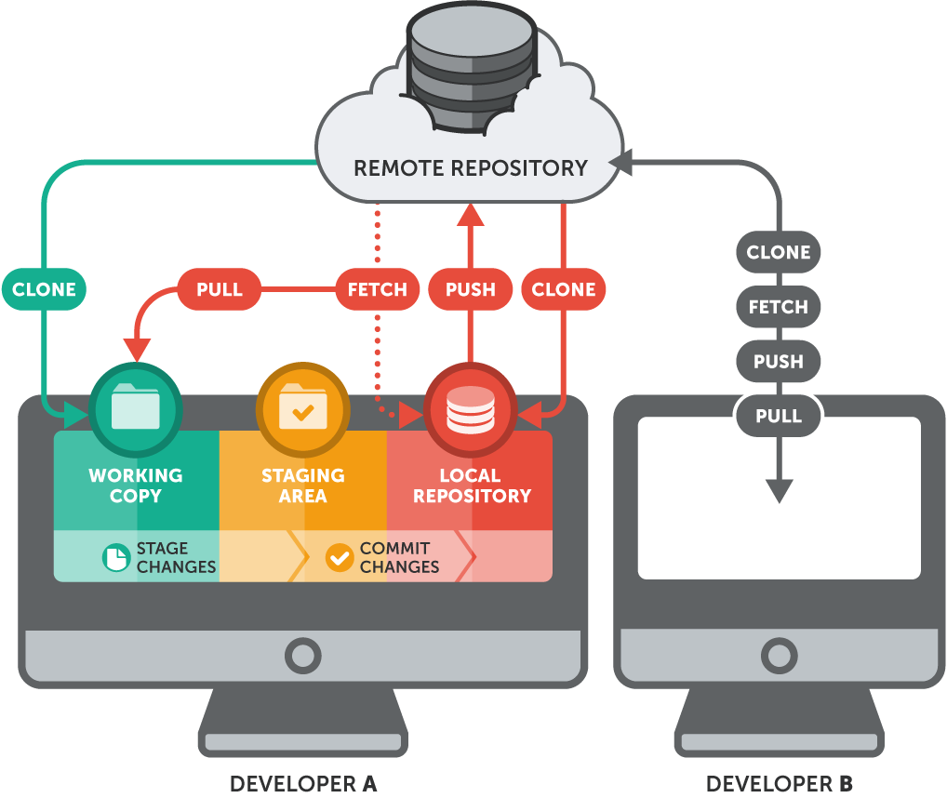
git Flow
Notes:
Stage:
Add
Commit
Push

Slide 27
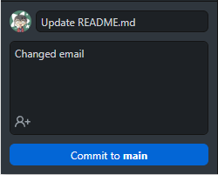
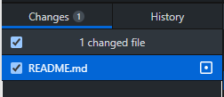

Commiting
About-Me
Computer
README.md
Work Copy
Staging Area
Local Repository
Notes:
Showing the where the files are

Slide 28
Push your changes
Make your changes show on Github

Slide 29


Github Desktop
Computer
Github
About-Me
About-Me
README.md
README.md
Notes:
Showing the where the files are

Slide 30
3.
A bit more on version control
What is it?

Slide 31
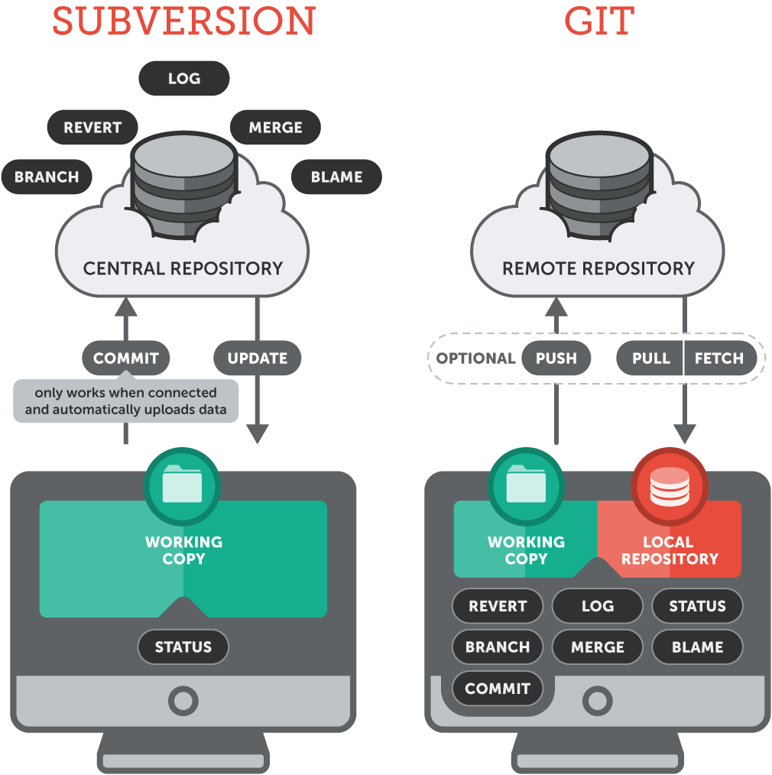
Version Control Types

Slide 32

Version Control Types
Centralised Version Control
1 central server
Each person checks out and merges back into the main server
Distributed Version Control
Each person has a local repository
This is then merged with the main server

Slide 33
3.
Collaboration
Branches

Slide 34
Pair up!
Get the username of the person next to you

Slide 35
Pair up!
Get the Github Username of the person next to you
Add them as a collaborator into your repo

Slide 36
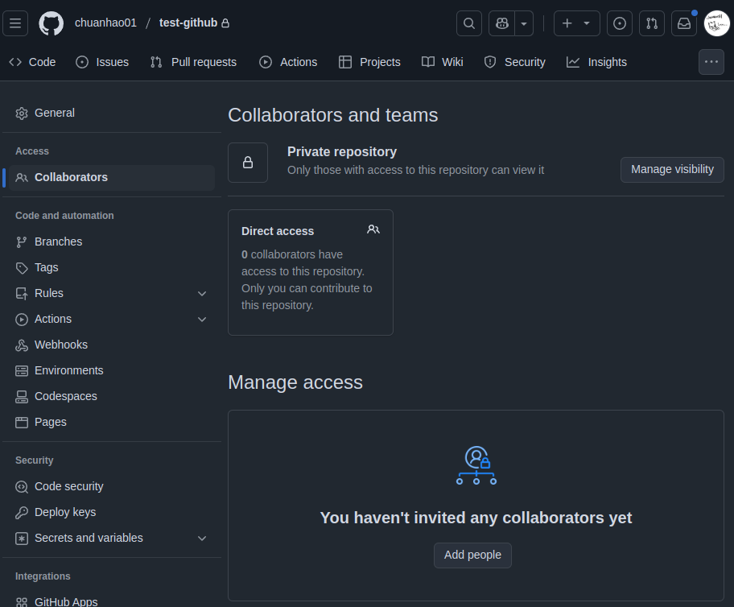
Pair up!

Slide 37
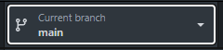
Our current flow
Person A
main
Add README
Edit
README
Edit
README
Notes:
Ok, just demo this
Tell them not to do this
And show them why its bad
Try adding a commit to someone else’s branch

Slide 38
Our current flow
Person A
Person B
main
Add README
Edit
README
Edit
README
Add
B.md
Edit
README
Notes:
Try adding a commit to someone else’s branch

Slide 39
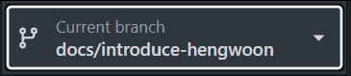
Branching
Person A
Person B
docs/B
Add
B.md
main
Add README
Edit
README
Edit
README
Notes:
Now try branching off and making some changes to your file

Slide 40
Branching
Person A
Person B
docs/B
Add
B.md
main
Add README
Edit
README
Edit
README
Merged
dev-B
Notes:
Now try branching off and making some changes to your file

Slide 41
4.
Pull Requests
The social part of Github
Notes:
Explain PRs
Explain Forks
Show Forks
Show PRs

Slide 42
Let’s Create a PR

Slide 43
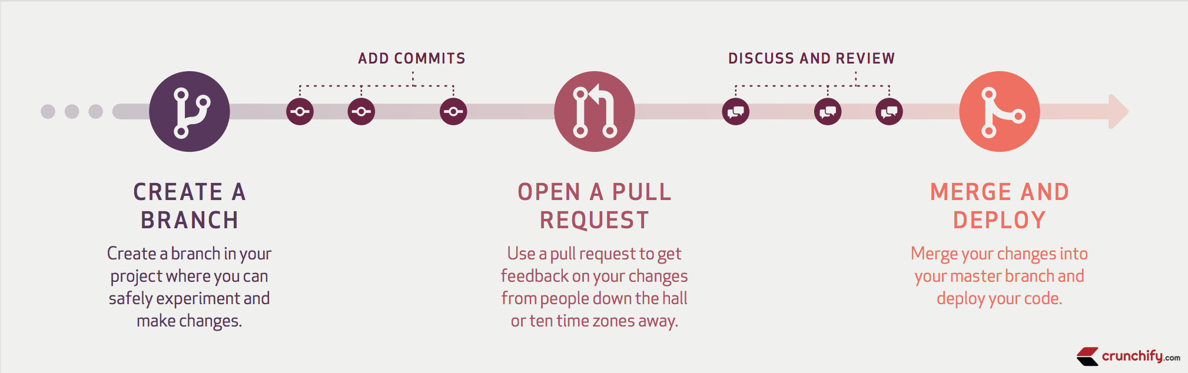
When you might use it

Slide 44

Pull Requests
Person A
Person B
dev-B
Pull Request
Add
B.txt
Edit
README
main
Add README
Edit
README
Edit
README
Edit
README
Merged
dev-B
Notes:
Now try branching off and making some changes to your file

Slide 45


Pull Requests
Person A
Person B
dev-A
Edit
README
dev-B
Add
B.txt
main
Add README
Edit
README
Edit
README
merge
dev-B
merge
dev-A
Notes:
Now try branching off and making some changes to your file

Slide 46
What we’ve done

Slide 47
Our Flow
Person A
Person B
dev-A
Edit
README
dev-B
Add
B.txt
main
Add README
Edit
README
Edit
README
merge
dev-B
merge
dev-A
Notes:
Now try branching off and making some changes to your file

Slide 48
Our Flow
Person A
Person B
2. Added
Commits
dev-B
1. Created a branch
Add
B.txt
Edit
README
main
3. Merged
Add README
Edit
README
Edit
README
Edit
README
Merged
dev-B
Notes:
Now try branching off and making some changes to your file

Slide 49
MERGE CONFLICTS

Slide 50
Branching
Person A
Person B
docs/B
Add
B.txt
Edit
README
main
Add README
Edit
README
Edit
README
Edit
README
Notes:
Now try branching off and making some changes to your file

Slide 51

Branching
Person A
Person B
docs/B
Add
B.txt
Edit
README
main
Add README
Edit
README
Edit
README
Edit
README
Merged
dev-B
Notes:
Now try branching off and making some changes to your file

Slide 52
Merge Conflicts
Don’t have merge conflicts!
Small features/fixes
Pull & update often
Be mindful of conflict during project planning

Slide 53
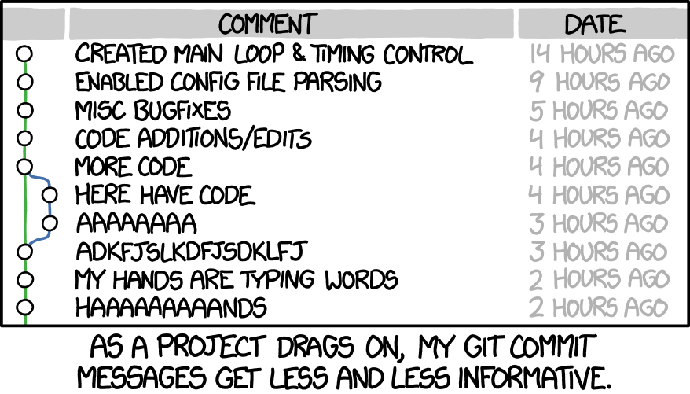

Extras
What we don't have time for
Notes:
Explain PRs
Explain Forks
Show Forks
Show PRs

Slide 54
Git Ignore
When you got other files

Slide 55
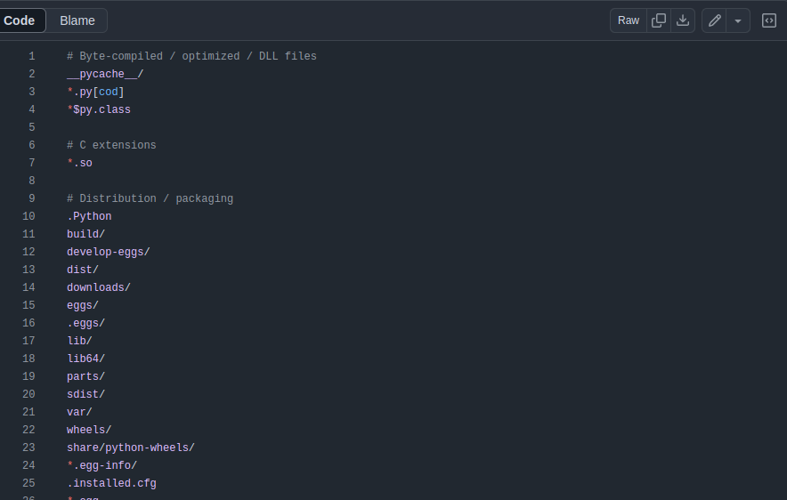
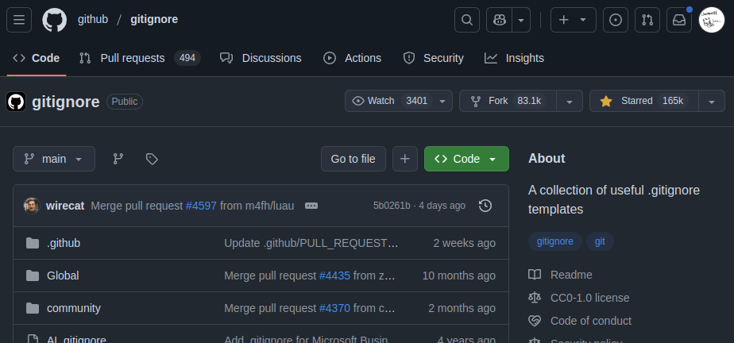
Git Ignore
github.com/github/gitignore
Notes:
Now try branching off and making some changes to your file

Slide 56

Git Flow
When you gotta code
Notes:
Mostly for larger projects
When you have like 20 people all contributing code and features
You need a system to for code review CI/CD Devops
Production cannot be brought down with rouge commits
Accountablility for code etc
Smaller scale exists too
You have git flow
Just that you don’t need a bunch of needless processes and meetings and code review etc

Slide 57
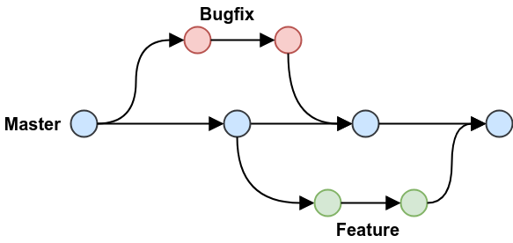
Git Flow
Notes:
Now try branching off and making some changes to your file

Slide 58
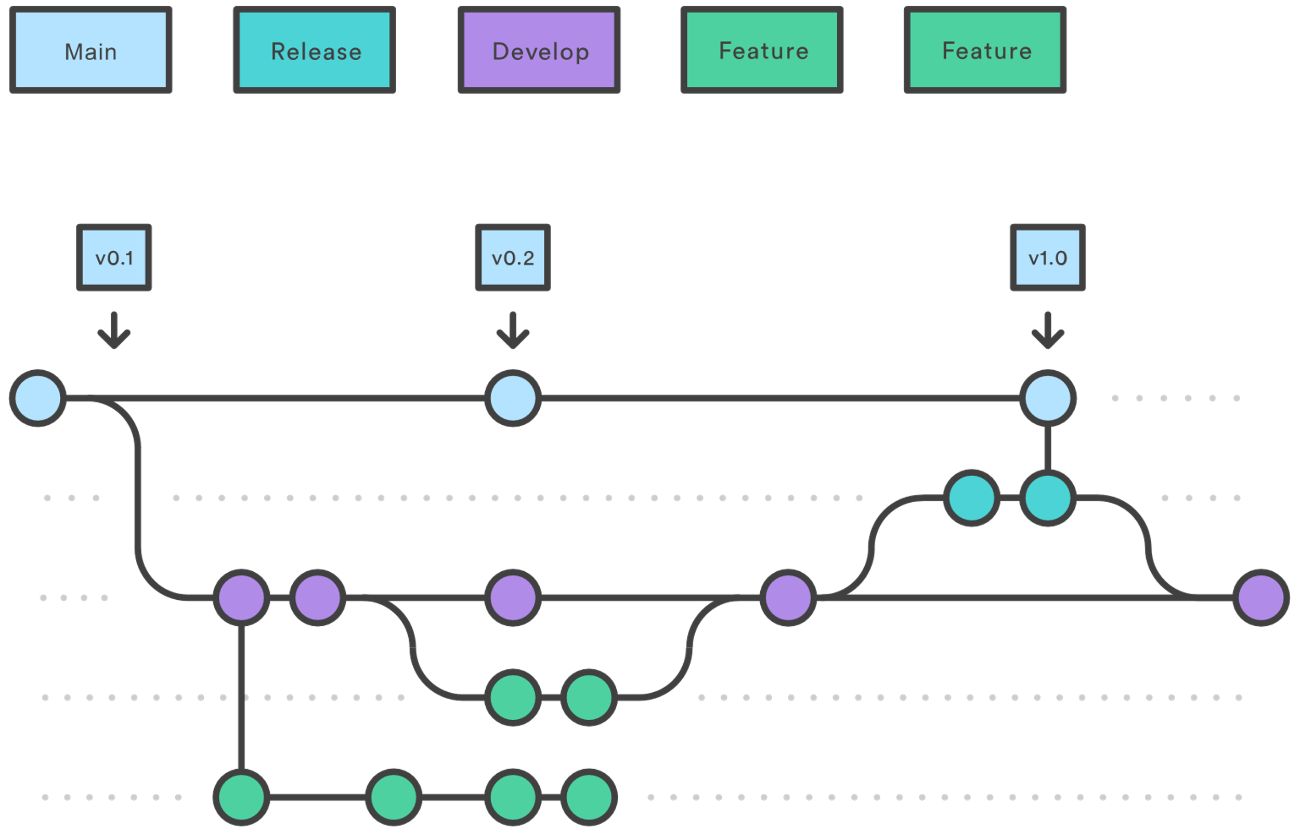
Git Flow
https://www.atlassian.com/git/tutorials/comparing-workflows/gitflow-workflow
Notes:
Now try branching off and making some changes to your file

Slide 59
Git Tools
Better GUIs?

Slide 60
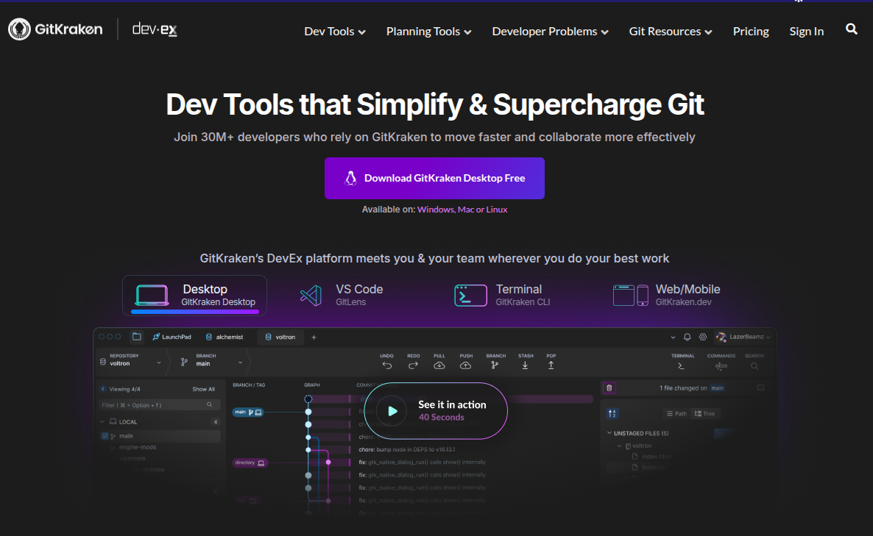
Git Tools
Notes:
Now try branching off and making some changes to your file

Slide 61
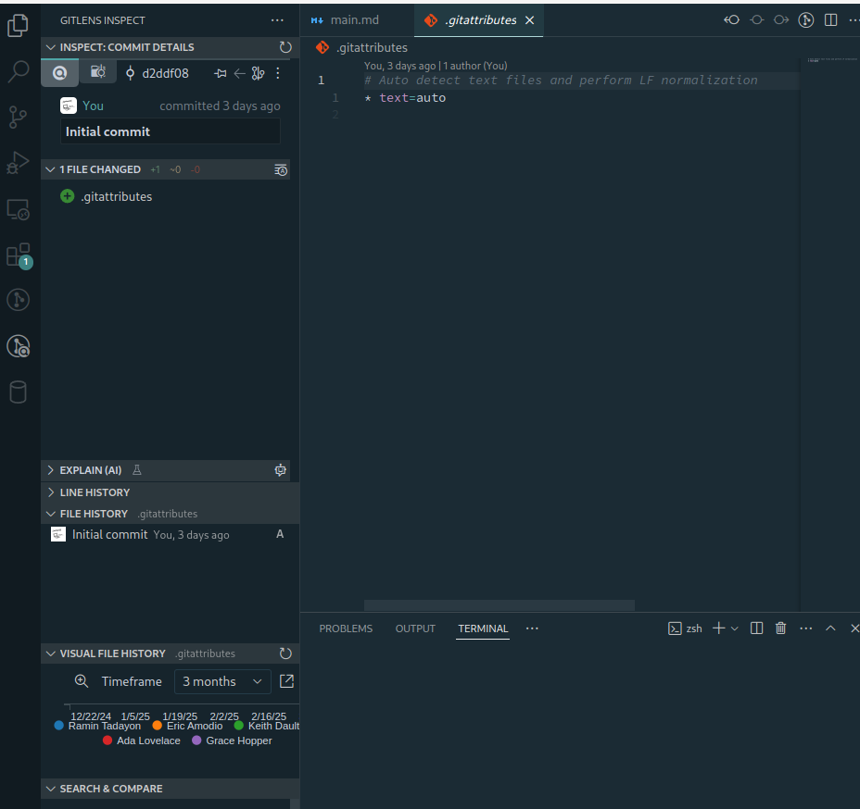
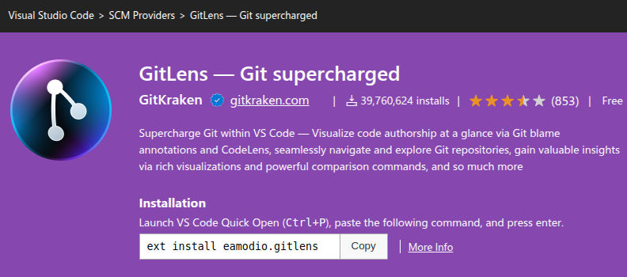
Git Tools
Notes:
Now try branching off and making some changes to your file

Slide 62
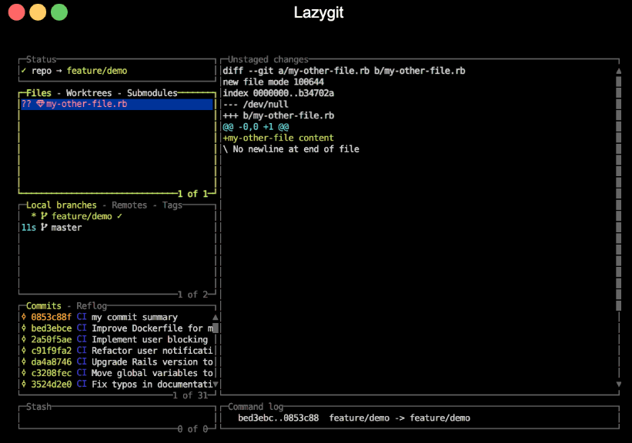
Git Tools
Notes:
Now try branching off and making some changes to your file

Slide 63
Git Providers
There are others?
Notes:
Explain PRs
Explain Forks
Show Forks
Show PRs

Slide 64
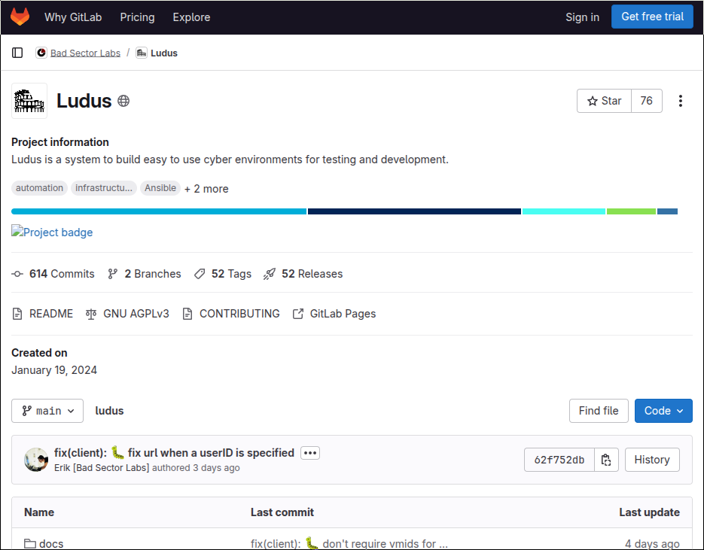
Git Providers

Slide 65
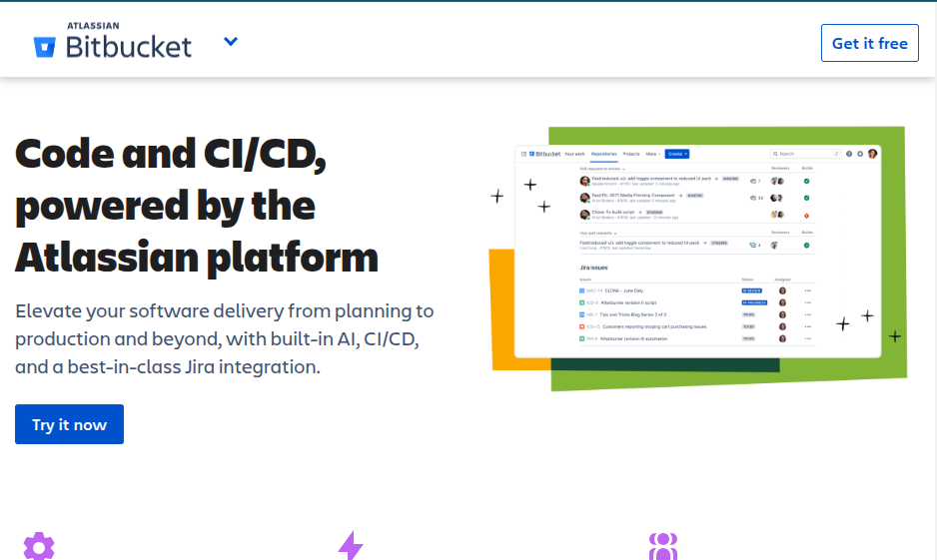
Git Providers

Slide 66
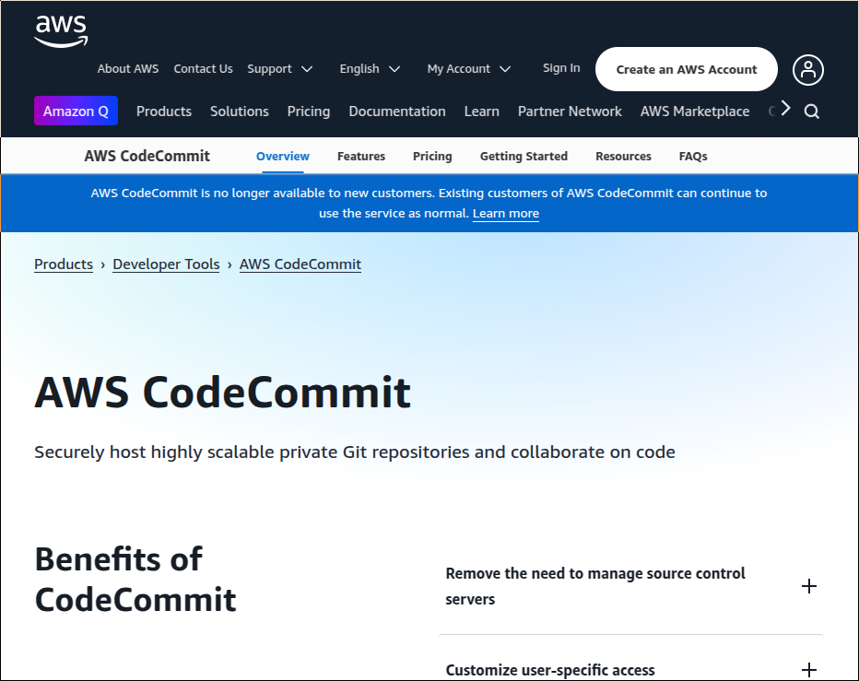
Git Providers

Slide 67
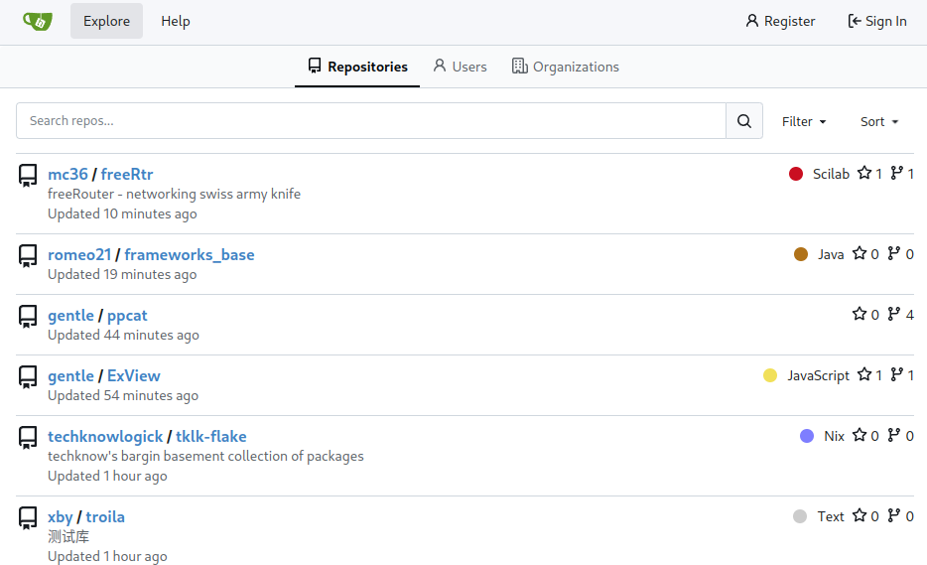
Git Providers

Slide 68
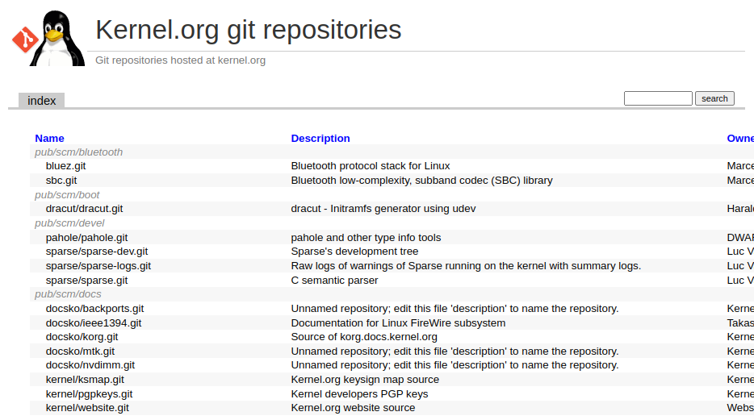
Git Providers

Slide 69
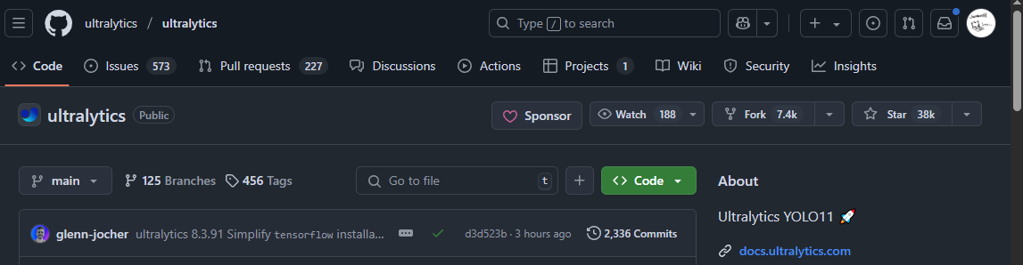
Forking
The social part of Github (And FOSS)
Notes:
Explain PRs
Explain Forks
Show Forks
Show PRs

Slide 70
Forking
You
User B
Cool Project
Cool Project
Notes:
Forking is copying from another repo

Slide 71
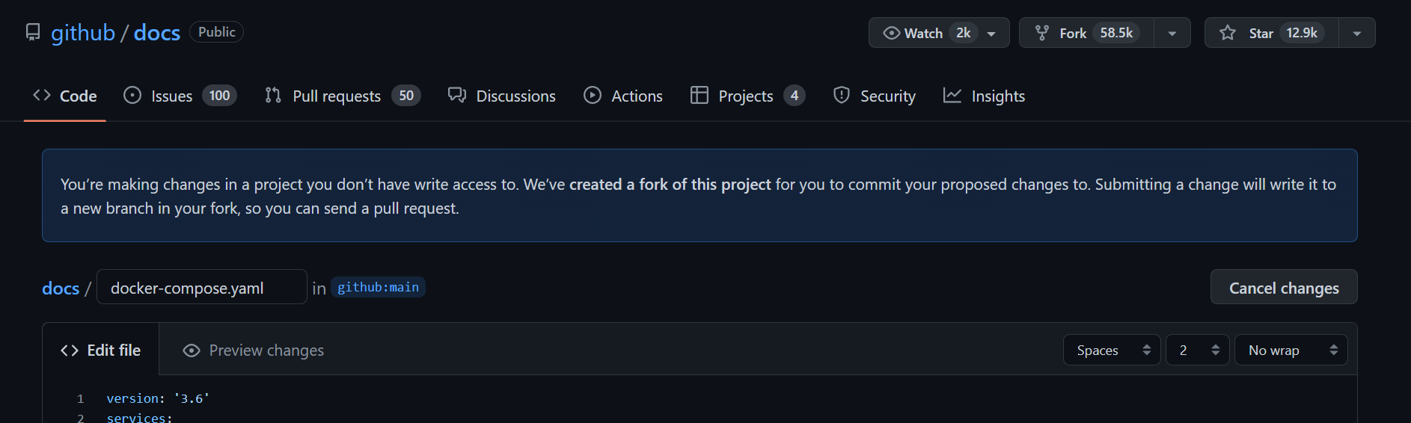
When you might use it
If you want to make changes to a repo you don’t control, you can fork it then make a Pull Request

Slide 72
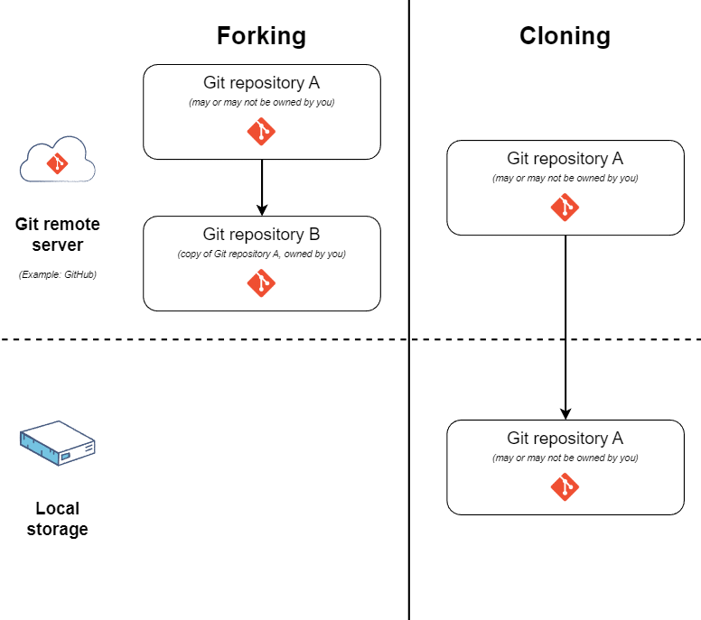
Forking Vs Cloning
educative.io/answers/what-is-the-difference-between-forking-and-cloning-in-git
Notes:
Now try branching off and making some changes to your file

Slide 73
Git Config
When you got multiple identities

Slide 74
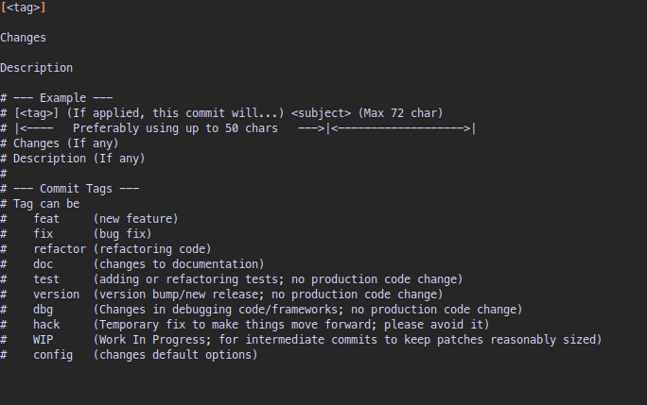
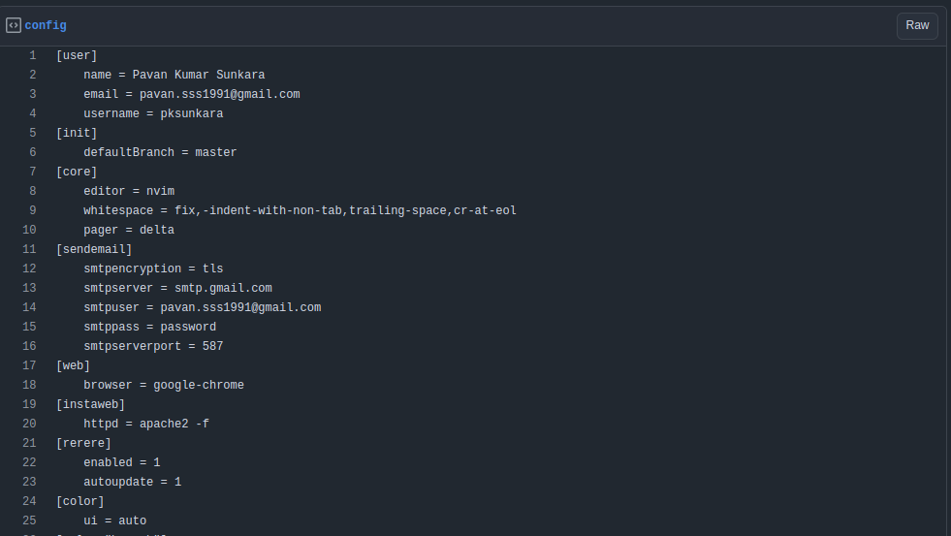
Git Config
Notes:
Now try branching off and making some changes to your file

Slide 75
Git Commands (Extra)
When you need the CLI

Slide 76
Git Commands
rebase
cherry-pick
revert
diff
show
rm
reset
submodule
remote
log
stash
bisect
blame
Reflog
worktree

Slide 77
Git Attributes
Mostly to deal with windows vs linux

Slide 78
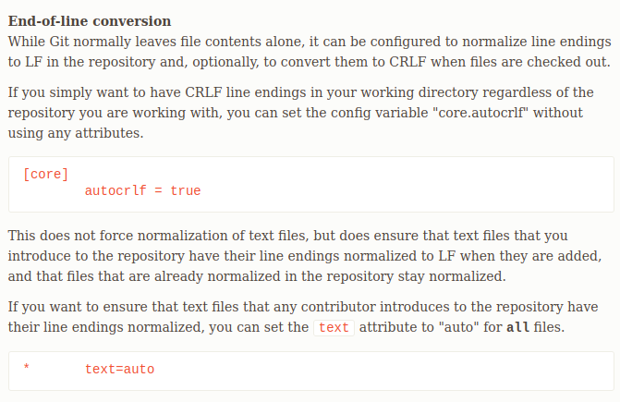
Git Attributes
Notes:
Now try branching off and making some changes to your file

Slide 79
Git Hooks
Automate stuff

Slide 80
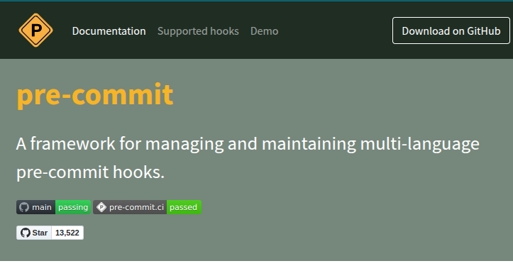
Git Hooks
Notes:
Now try branching off and making some changes to your file

Slide 81
Git Auth
ssh exists

Slide 82
Git Auth
More widely supported
Works even without a cloud provider
Bare bones and works with config
Notes:
Now try branching off and making some changes to your file

Slide 83
Git Security
Cyber?

Slide 84
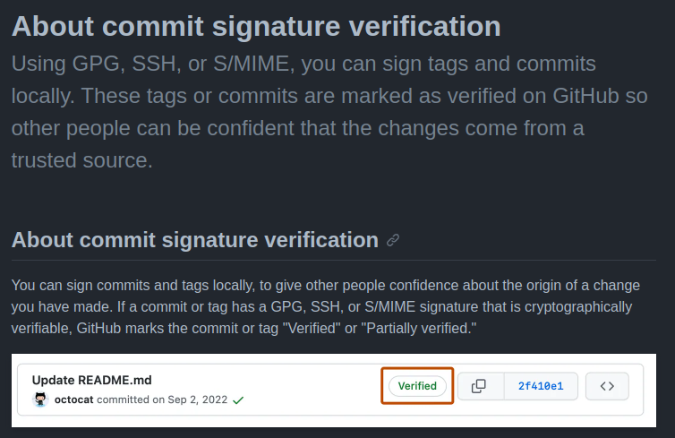
Git Security
Author name and email
Signing git object (i.e. commits, tags)
GPG – Good luck
Notes:
Now try branching off and making some changes to your file

Slide 85
Thanks!
Any questions?

Slide 86


Follow our Socials!
@innovation.lab.ccds
Innovation Lab @ NTU CCDS

Slide 87
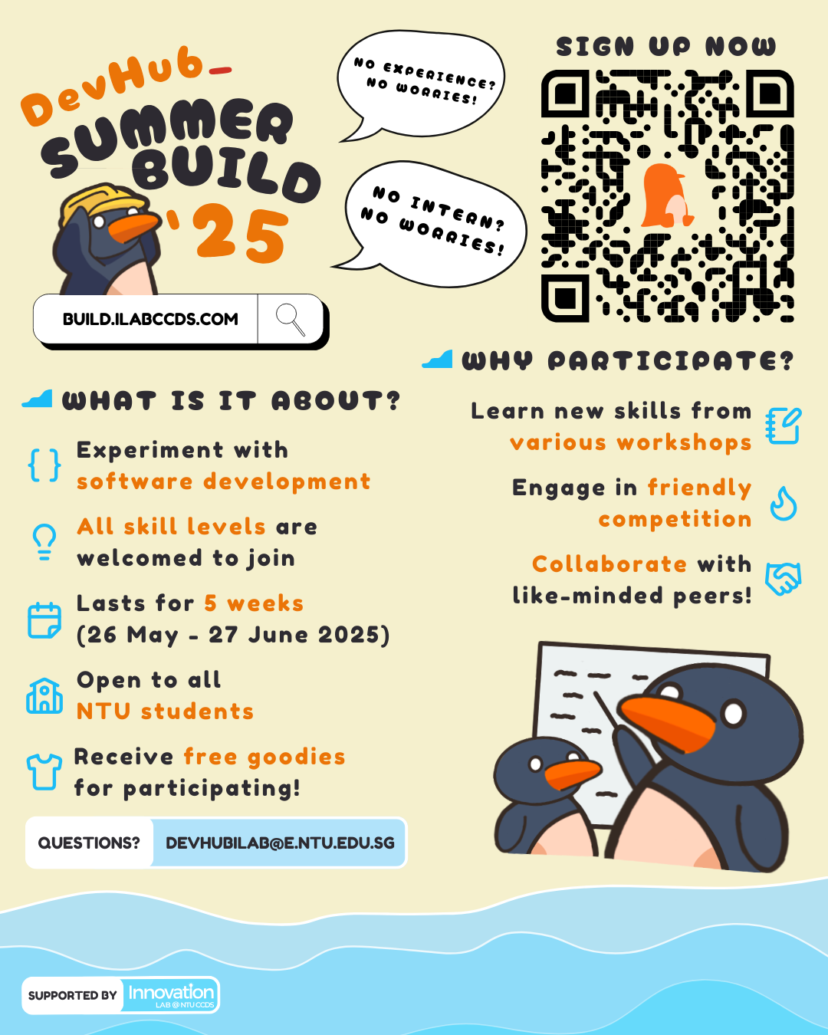


Fun workshops for Software Dev
Build anything you want
Prizes & Challenges
Free Swag & Snacks
Certificates for LinkedIn
For more info: build.ilabccds.com

